Slide 1
RDF Viewer
• Features
• Installation
• Usage

Slide 2
RDF Viewer
Function
View RDF
Minimum compilation effort
Analyze NOKIA data
Draw on the map with SQL queries
Integrated view with other NOKIA products & services
Platform
Runs on Windows / Linux / MacOS – plain Java
Works with all databases – Oracle / SQLServer / PostgreSQL / MySQL / SQLite
Works with all RDF releases since 2010 Q4

Slide 3
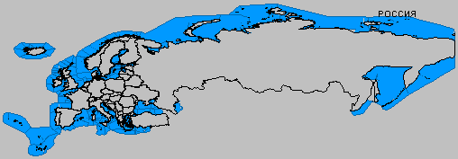
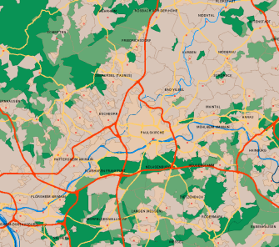
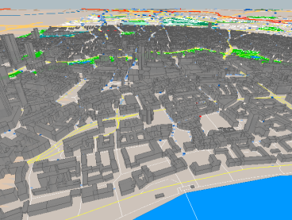
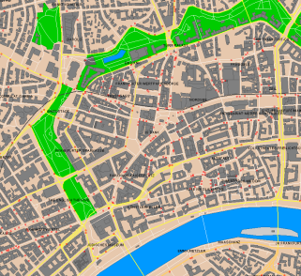
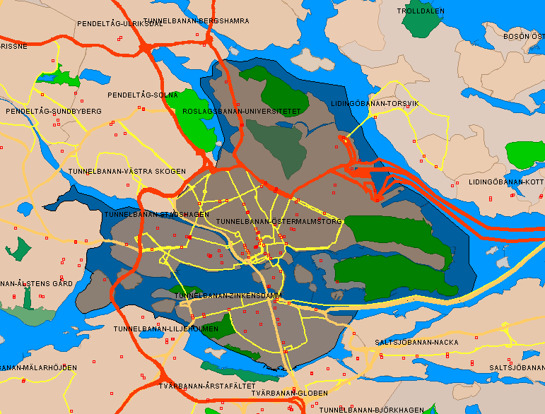
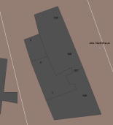
Carto Areas / Lines / POIs
2D & 3D

Slide 4
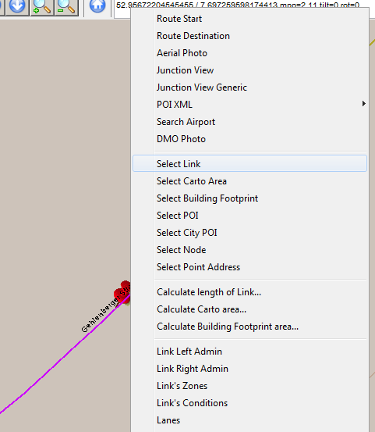
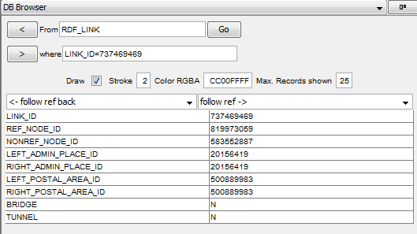
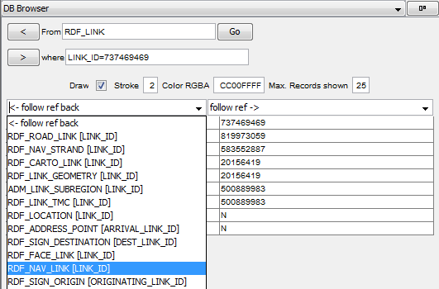
Map Objects
Browse Map Objects: Node, Link, Cartos, Admins...
Navigate through the map via database reference

Slide 5
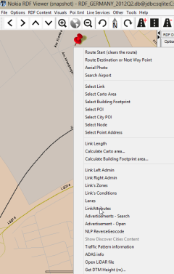
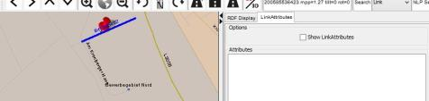


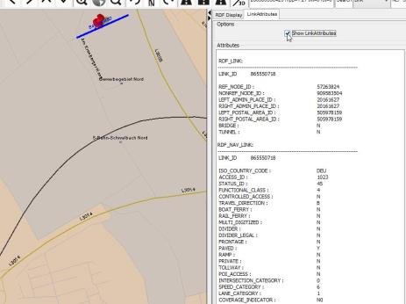


Link Attributes
Content:
RDF_LINK
RDF_NAV_LINK
RDF_NAV_LINK_STATUS
CONDITIONS like
CONDITION_ID, CONDITION_TYPE,
ATTR_DESCRIPTION, SEQ_NUM, NODE_ID

Slide 6
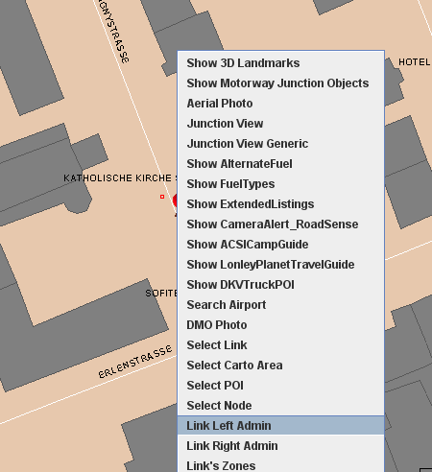
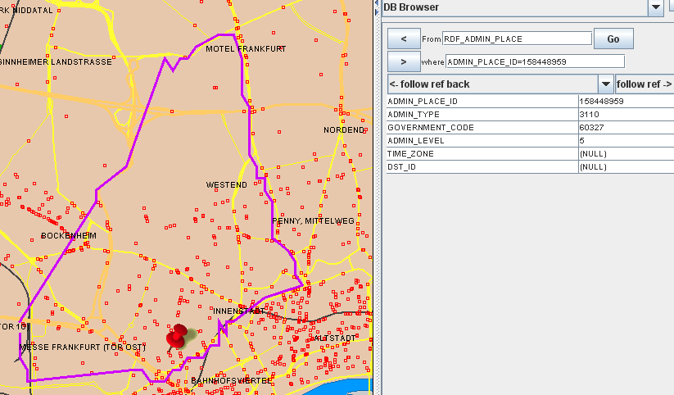
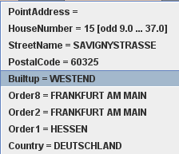
Admin Structure
Generates polygon from Link-Admin relationship,
if admin has no carto polygon

Slide 7
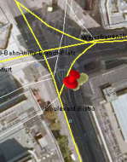
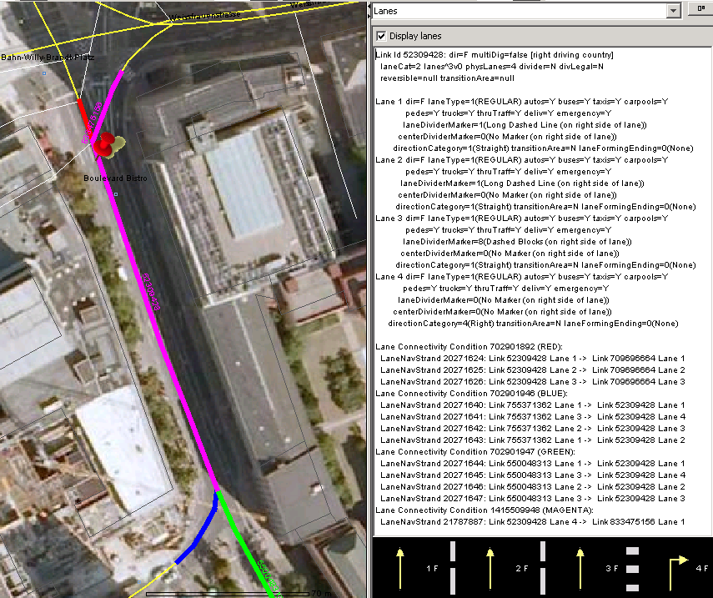
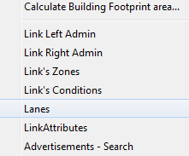
Lanes

Slide 8
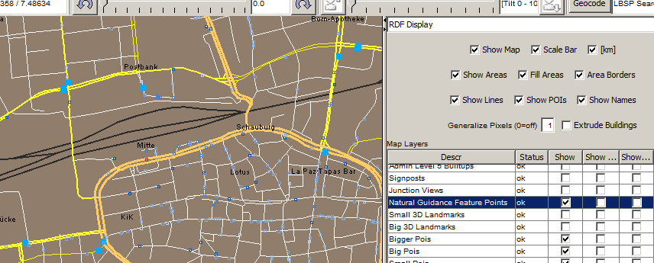

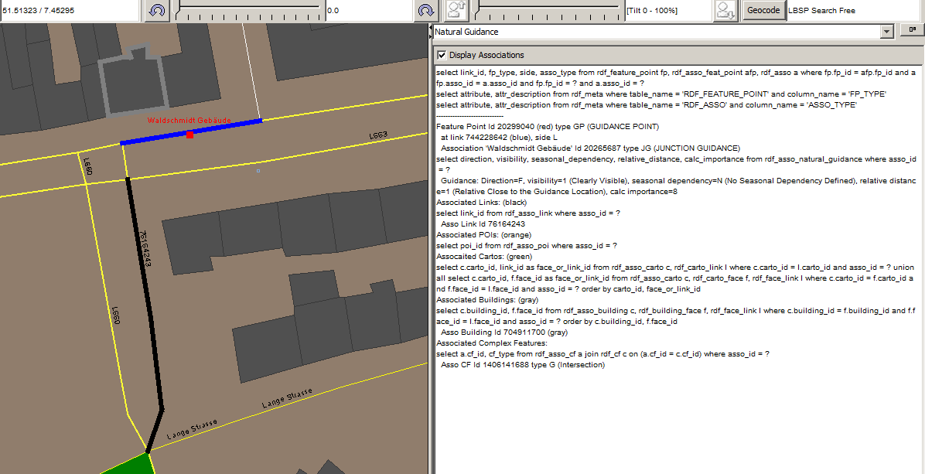
Natural Guidance

Slide 9
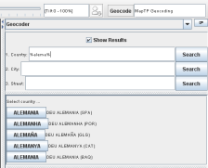
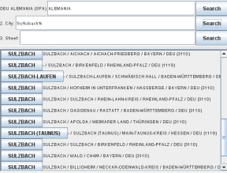
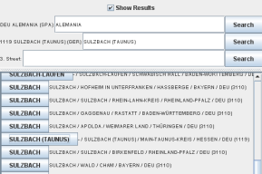
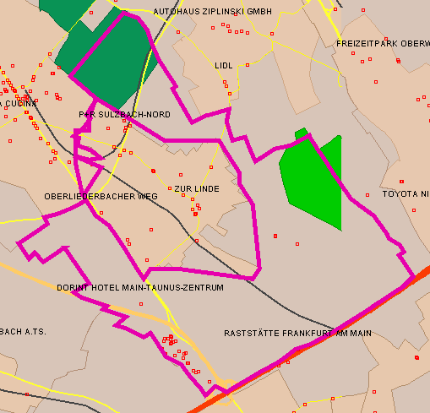
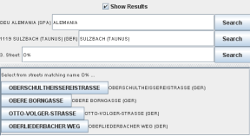
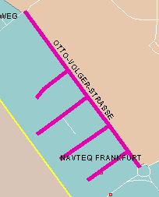
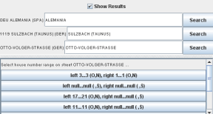

Geocoding
Sulzbach Polygon
Otto
Volger Str

Slide 10
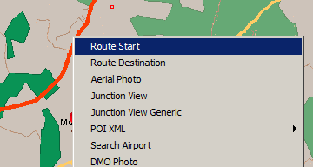
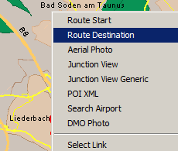
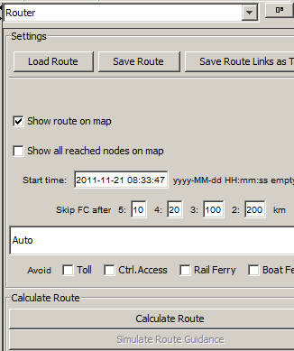
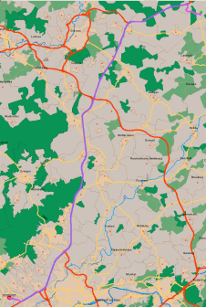
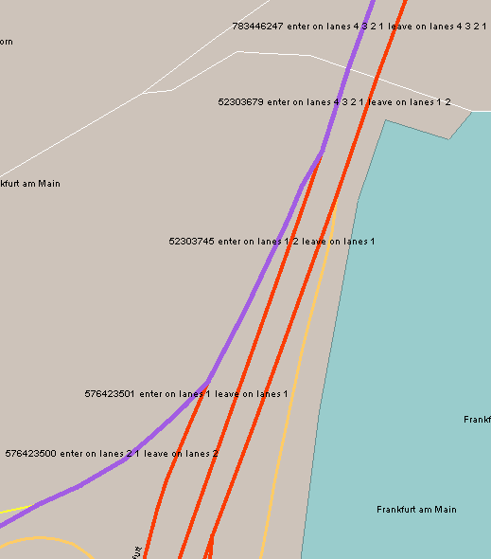
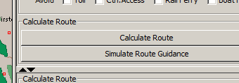
Routing
1.
2.
3.

Slide 11
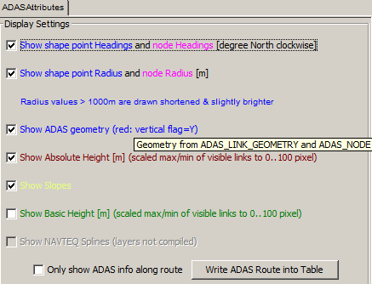
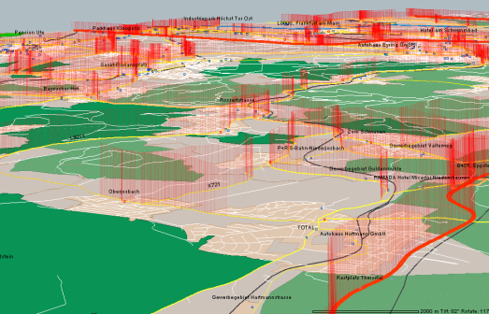
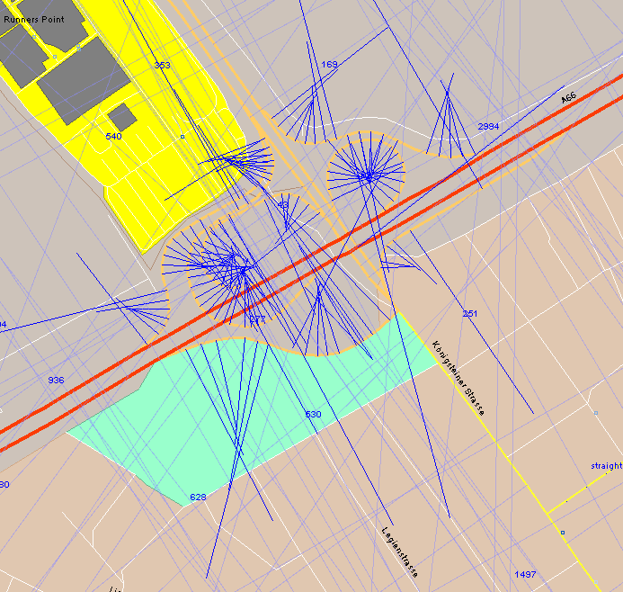
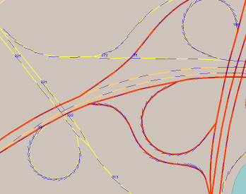
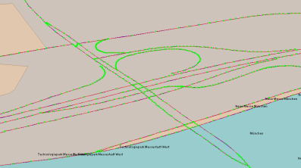
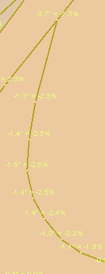
ADAS Curvature, Height, Slope, Heading, Splines
Height
Heading
Splines
Slope
Radius

Slide 12
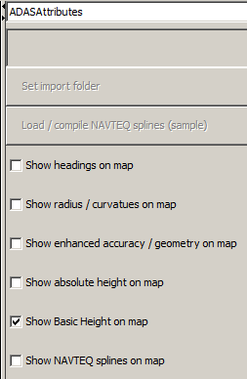
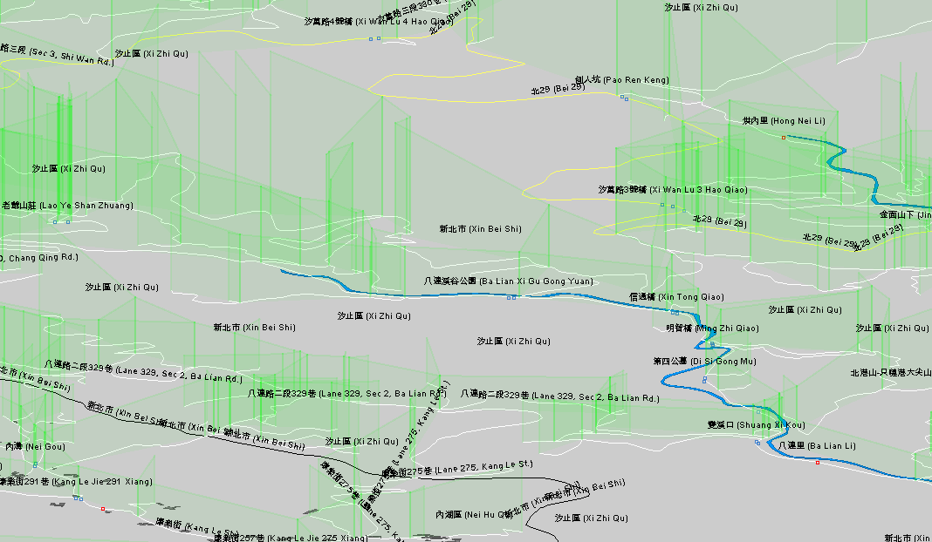
ADAS Basic Height

Slide 13
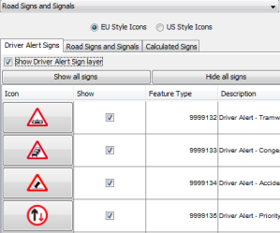
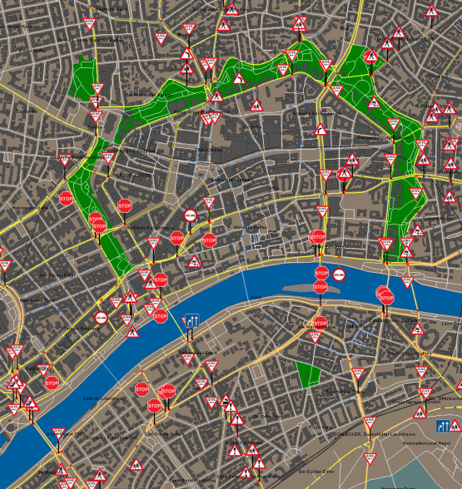
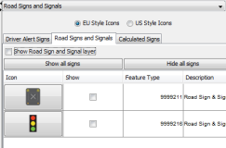
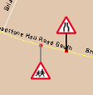
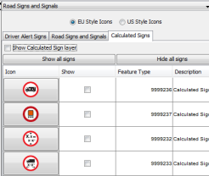
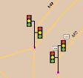
Driver Alert, Road Signs & Signals, Calculated Signs
Speech bubble if relevant for Natural Guidance

Slide 14
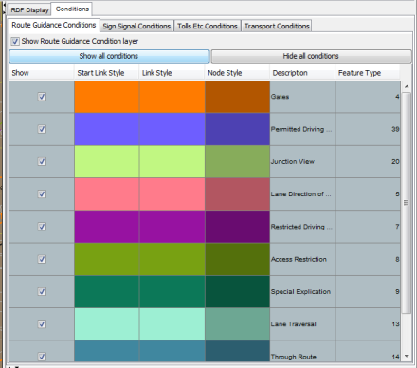
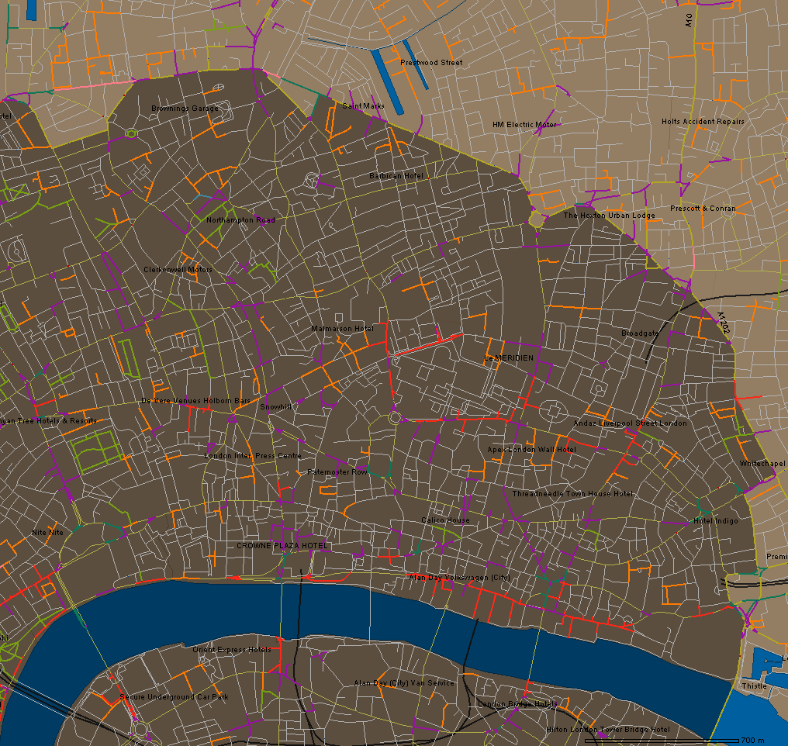
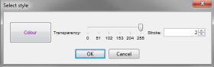
Conditions

Slide 15



Speed Limits

Slide 16


Disputed Territories
Get disputes.. – creates interface according to disputes present in the RDF
Each feature which provides Disputed attribution, for each country in the dispute, is shown here.
Click to change style
Tool tip explains what is displayed
When the user displays a feature a query is executed on the core RDF tables to retrieve the geometries to display – the query is shown in the log window – this helps customers understand the tables behind the Disputed Territories attribution.

Slide 17




Signposts

Slide 18








Roundabouts

Slide 19


RDF SQL Queries

Slide 20
Non-RDF Content
NOKIA Content outside RDF can be integrated
… by simply specifying the file path
Following slides show non-RDF content

Slide 21

POI Brand Icons

Slide 22


2D Landmarks

Slide 23






3D Landmarks
Switch to
3D mode

Slide 24



POI XML Products

Slide 25









Guided Tours

Slide 26




Enhanced Junction View + 2D Signs
Plan a Route

Slide 27




2D Generalized Junction Visuals + Signs
Plan a Route

Slide 28






Motorway Junction Objects
Plan a Route
Switch to 3D mode

Slide 29




Advanced 3D City Models
Plan a
Route

Slide 30



Transport & Pedestrian
Virtual Connections
Display
Routing
Schematic Transit Lines
Display

Slide 31



Traffic Patterns

Slide 32



LiDAR Point Clouds (NAVTEQ True)

Slide 33






Digital Terrain Model

Slide 34





Venue Maps
Display
Routing

Slide 35

Enhanced Elevation Contours

Slide 36




High Priority Updates (DDF)

Slide 37
Platform Services
HERE Platform Web Services can be integrated
… just an access key required
Following slides show Services

Slide 38


Real Time Traffic

Slide 39


Air Travel Status

Slide 40

NLP Routing
Scenic
Economic
Fastest Now

Slide 41




NLP Routing - Isoline, Matrix

Slide 42




NLP Batch Geocoding

Slide 43



NLP Search

Slide 44


NLP Satellite Images

Slide 45





Augmented Reality Service (Live Sight)
Coverage Area
Panorama Viewer

Slide 46



Auto Cloud Parking Info

Slide 47


Auto Cloud Electric Vehicle Charging

Slide 48


Auto Cloud Fuel Prices

Slide 49


Auto Cloud Weather

Slide 50



Field Drive Imagery (internal only)

Slide 51
Run RDFViewer

Slide 52
Hardware & Software Requirements
Operating Systems
Windows 32 / 64 bit
Linux
MacOS ( SQLite, OpenGL and SQLServer int. Auth. not supported )
Java ≥ 1.7
RDF map on Oracle, MS SQLServer, PostgreSQL, MySQL, SQLite
Network ≥ 10 Mbit/s between RDFViewer and database

Slide 53

Install + Run
Download URL: http://tcs.navteq.com/http-proxy/RDFViewer/
Unpack ZIP archive into an installation directory
No configuration required
Run RDFViewer using “run.bat”
Choose a database
Web service lists all available RDF map databases (optional)
Online update

Slide 54


Pre-Compile Maps
Pre-compile RDF map
approx. 8 hours for EU
creates one RDFPL_ database table per map display layer
For non-RDF content, the file paths must be given (downloaded from EDD, untar-ed)
multiple paths “ ; ” separated
For the Junction View layer, also enter the path to the Sign As Real Files

Slide 55
RDF Tools
RDFViewer comes with Tools:
RDF Installer
RDF Clipper / Merger
Export to File
Import from File
Connect GPS Receiver
Create polygons for all admin boundaries
Rasterize 2D Generalized Junctions

Slide 56



Tools Installing RDF with RDFViewer
into Oracle, SQLServer, PostgreSQL, MySQL, SQLite
empty database must be created manually
RDF TAR files from EDD must be unpacked
open it in RDFViewer → Error message “Database emtpy”
specify a temp directory big enough to store unzipped loaderfiles

Slide 57


Tools Clip a Region out of RDF
RDF Loaderfiles → Clip selected Admin region(s) → RDF Loaderfiles
Clip by country-code, admin area ID or product-region code (VSAM)
No database involved, no need to load a continental RDF into database
Result is a full RDF product that can be installed into any database

Slide 58


Tools Merge RDF maps
Load 1st RDF into database, then load 2nd RDF into same database, …
Result are RDF tables filled with the records from all RDFs
Special merge actions are taken care of

Slide 59

Tools Export Query Result to File Shape**, Text, KML
Save ADAS attributes along route
**Shape file export allows for multiple files to be created based on a result column e.g. if you want to group the shape files by ISO country code….

Slide 60



Tools Import Files CSV, DBF, GPX, KML, Shape, XML, MS Access
XML import also as command line: import_XML.bat

Slide 61



Tools Connect GPS Receiver
GPS

Slide 62

Tools Create polygons for all admin boundaries
Select Carto IDs
Generates and write polygons into WKT files

Slide 63

Tools Rasterize 2D Generalized Junctions
render_Gen2DSigns.bat -jdbcurl … -dbuser … -dbpass … -productFilePaths …\generic_junction_views_weu;…\generic_motorway_signs_weu -targetDir … -aspectRatio 16x9 -pixelSizeX 640 -pixelSizeY 480

